Slide 1




Let’s
cooperate
win-win
LOGO
Company introduction
Xiamen Happiness Manufacture Technology Co., Ltd
We produce different massagers with excellent quality more than 11years, all materials we use can pass CE, GS, or BSCI inspection, welcome to cooperate with us.
Responsibility
Notes:
更多模板下载地址：http://www.pptvzaixian.com/shop/view28111.html（复制链接到浏览器打开）

Slide 2
Brief introduction
简介
Established Time
Our factory established, since 2010, found by Mr. JingWu Wang, have own brand “Jialekang”, he is not only a professional massagers designer, but also a trust/honest boss. he pay high attention to product’s quality, so he usually make samples for customers by himself.
Products
We only produce different massagers and do export by ourselves for more than 10 years, products include massage gun, massage pillow, neck and shoulder massagers, massage cushion, massage mattress, foot massager, massage chair etc, OEM and ODM service is available for mass orders.
01
02
Business scope
We produce different massagers and export them to worldwide directly, our main market: Europe and North America. We have established long-term business relationship with customers who from more than 20 countries.
Our wish
We hope our products can be found everywhere in the world, we hope all of our customers are satisfied with our products' quality and our after-service.
03
04
Notes:
更多模板下载地址：http://www.pptvzaixian.com/shop/view28111.html（复制链接到浏览器打开）

Slide 3


Story
Important case of Company
Happiness manufacturer founded
2010
Founded by Mr.Jingwu Wang, factory specialized in producing healthy care products: different massage equipments.
2021
Our achievements
Our massager products are expanded to more than 50 kinds, 4 production lines, 2000 square meters workshop, pass ISO-9001, CE, FCC,FDA,GS inspection. BSCI is applying. Export to more than 20 countries.
Notes:
更多模板下载地址：http://www.pptvzaixian.com/shop/view28111.html（复制链接到浏览器打开）

Slide 4
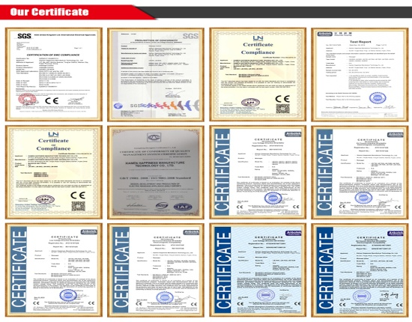
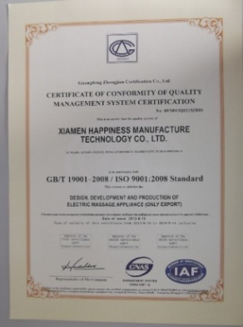
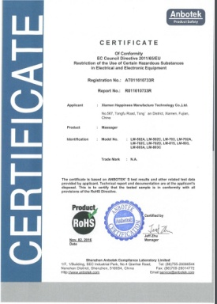
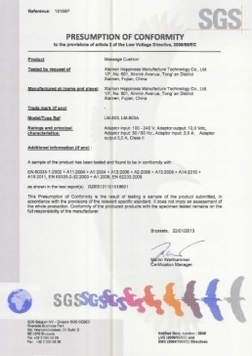
Certifications
1
2
3
4
CE certification
ISO9001-2008
RoHs
SGS
Notes:
更多模板下载地址：http://www.pptvzaixian.com/shop/view28111.html（复制链接到浏览器打开）

Slide 5
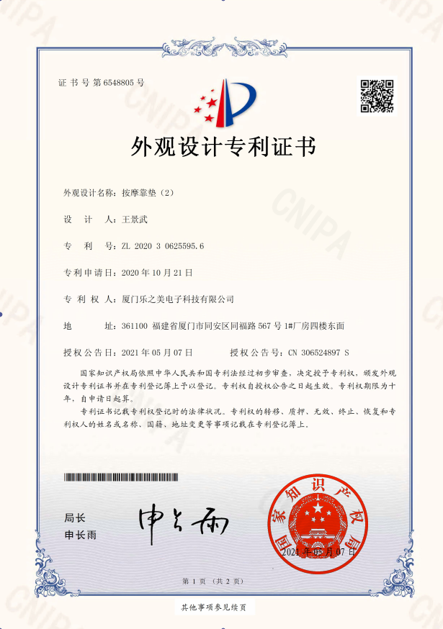
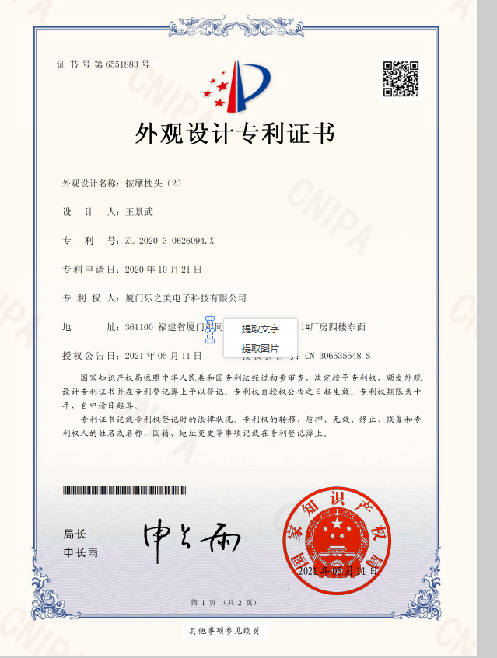
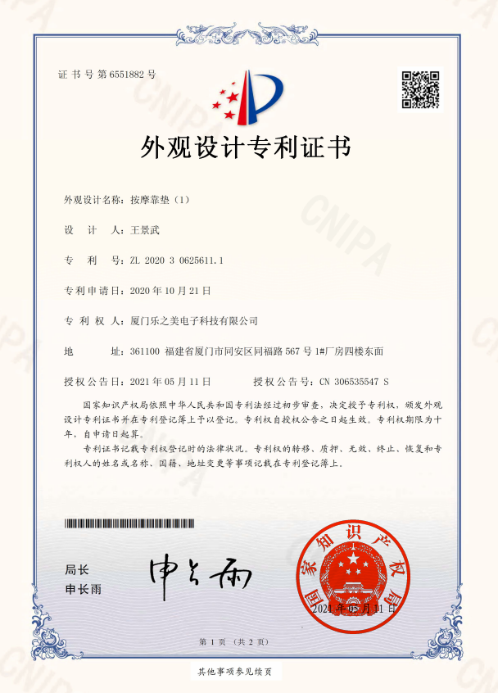
Patents
1
2
3
4
Notes:
更多模板下载地址：http://www.pptvzaixian.com/shop/view28111.html（复制链接到浏览器打开）

Slide 6
Our advantage
我们的优势
Rich manufacturing experience
Produce massagers only, More than 11 years, since Year 2010.
Low MOQ
MOQ 50pcs, everything is negotiable.
01
04
Enough capacity
4 production lines,
2000 square meters workshop
Warranty
Defective rate less than 2%, 12 months guarantee service.
02
05
1
2
3
Various kinds of massagers
Our massager products are expanded to more than 50 kinds, we have massage gun, massage pillow, neck and shoulder massager, back massager, massage cushion, foot massager, massage shoes, massage mattress, massage chair etc..
OEM/ODM
Available for mass orders.
03
06
Notes:
更多模板下载地址：http://www.pptvzaixian.com/shop/view28111.html（复制链接到浏览器打开）

Slide 7
catalogues
产品目录
Notes:
更多模板下载地址：http://www.pptvzaixian.com/shop/view28111.html（复制链接到浏览器打开）

Slide 8
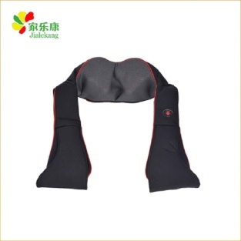
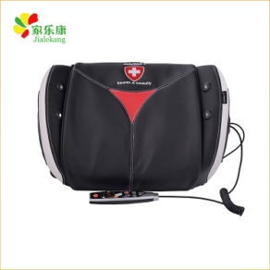
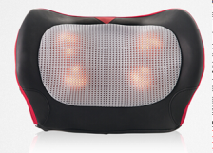
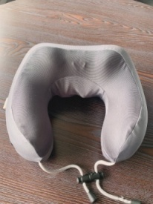
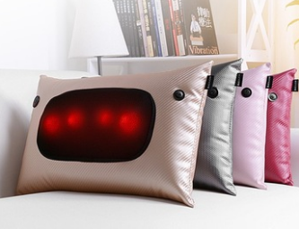
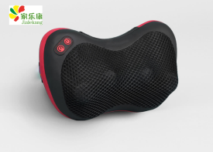
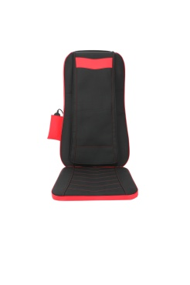
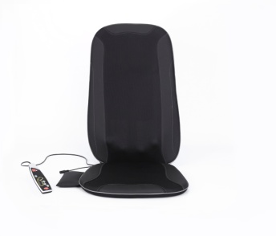
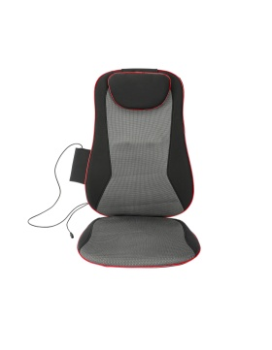
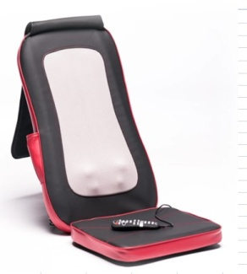
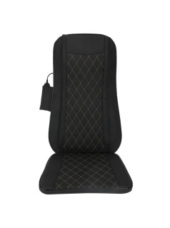
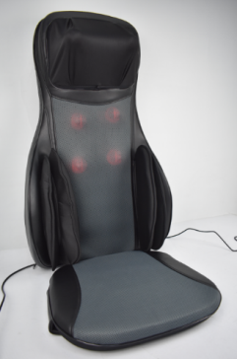
Product show
产品展示
Neck and shoulder massager
Neck and shoulder massager
back massager
Notes:
更多模板下载地址：http://www.pptvzaixian.com/shop/view28111.html（复制链接到浏览器打开）

Slide 9
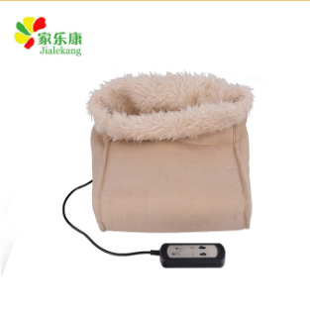
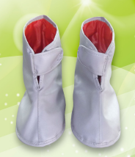
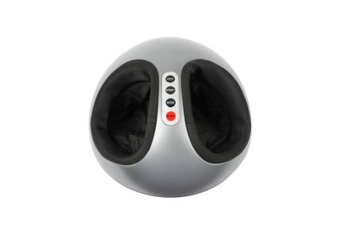
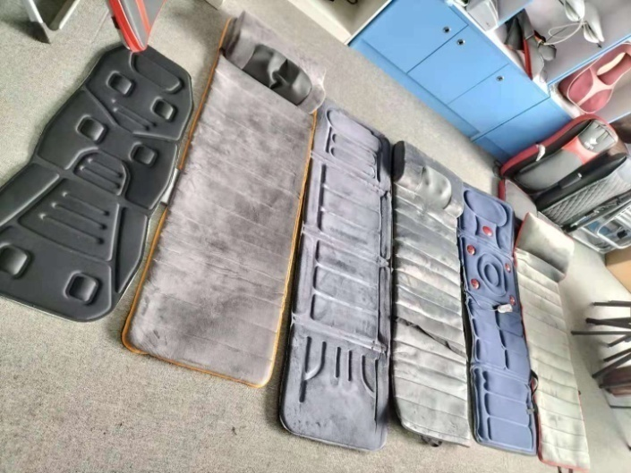
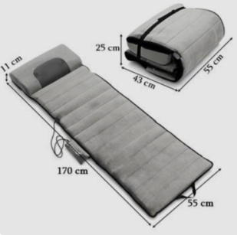
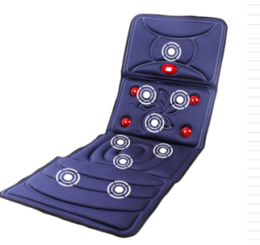
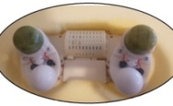
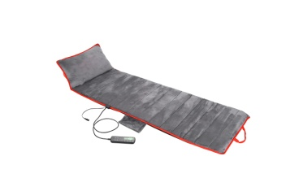
Product show
产品展示
Foot massager
Neck and shoulder massager
massage mattress
Notes:
更多模板下载地址：http://www.pptvzaixian.com/shop/view28111.html（复制链接到浏览器打开）

Slide 10
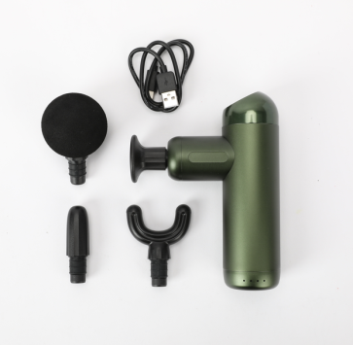
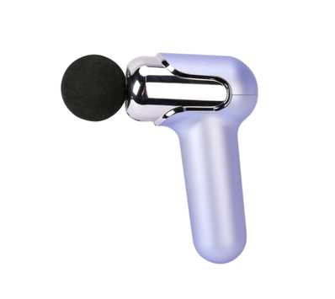
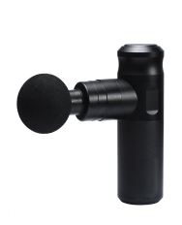
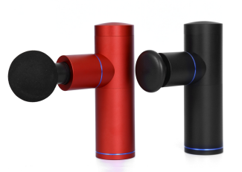
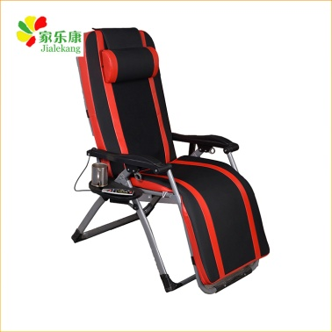
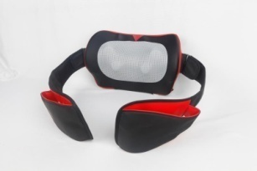
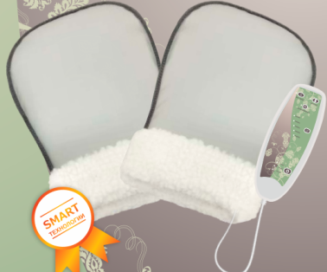
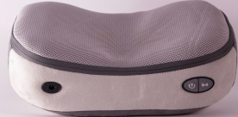
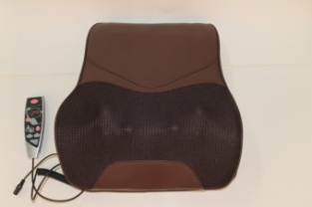
Product show
产品展示
Massage gun
Neck and shoulder massager
others
Notes:
更多模板下载地址：http://www.pptvzaixian.com/shop/view28111.html（复制链接到浏览器打开）

Slide 11
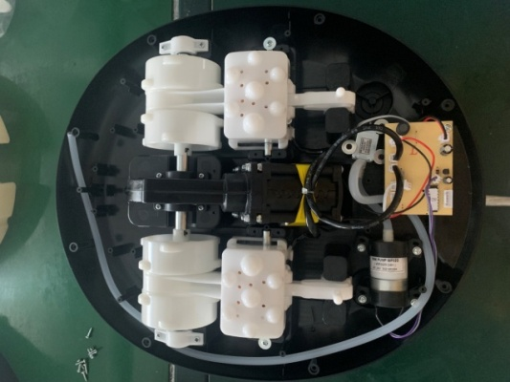
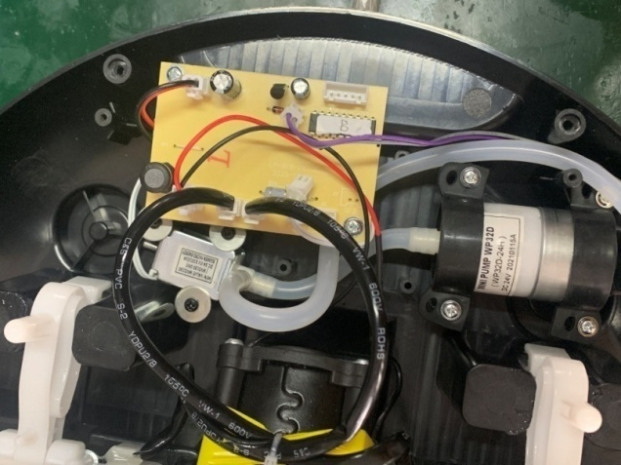
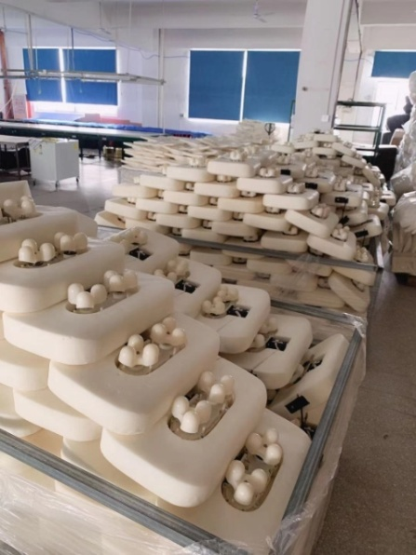
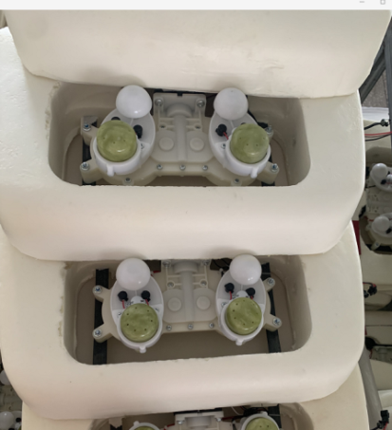
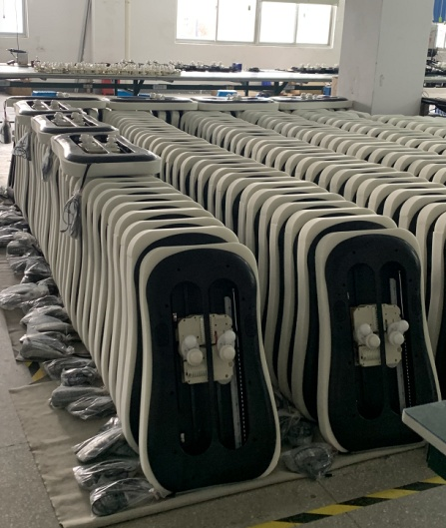
Product show
产品展示
Materials
We pay high attention to product’s quality, all materials which we use can pass CE, FCC,FDA,GS or BSCI inspection
Notes:
更多模板下载地址：http://www.pptvzaixian.com/shop/view28111.html（复制链接到浏览器打开）

Slide 12
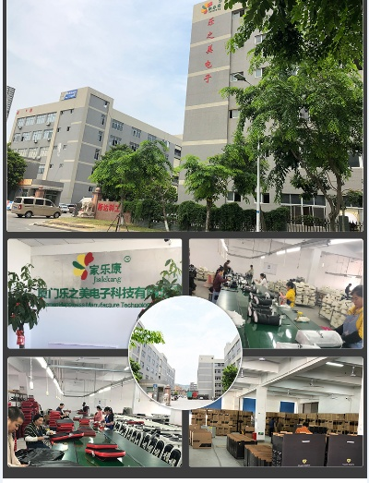
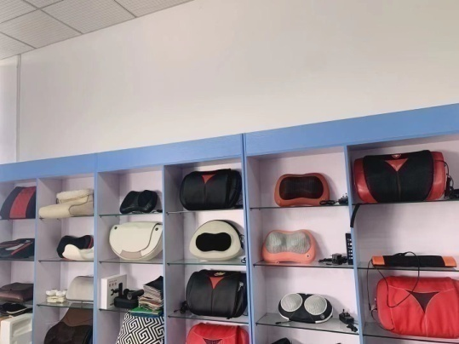
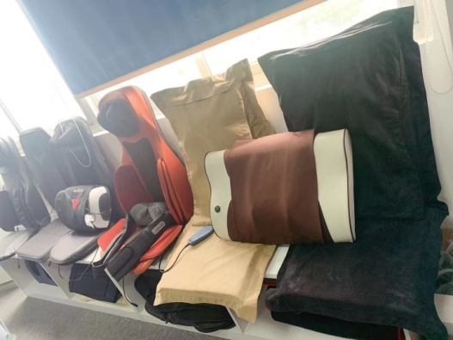
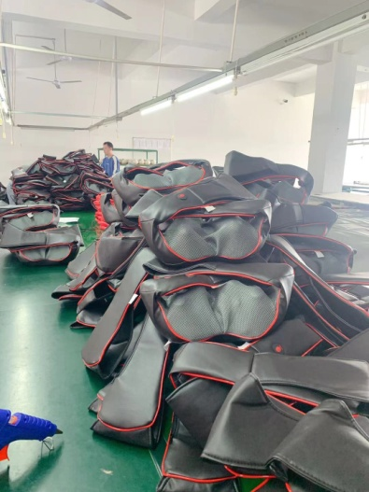
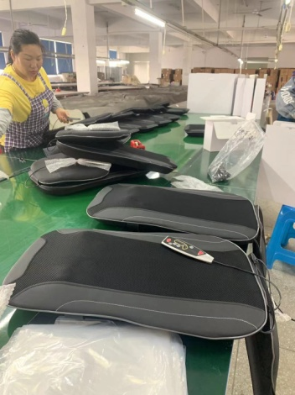
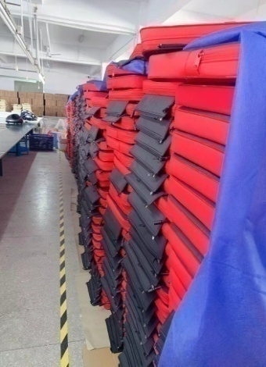
Factory show
工厂展示
Notes:
更多模板下载地址：http://www.pptvzaixian.com/shop/view28111.html（复制链接到浏览器打开）

Slide 13
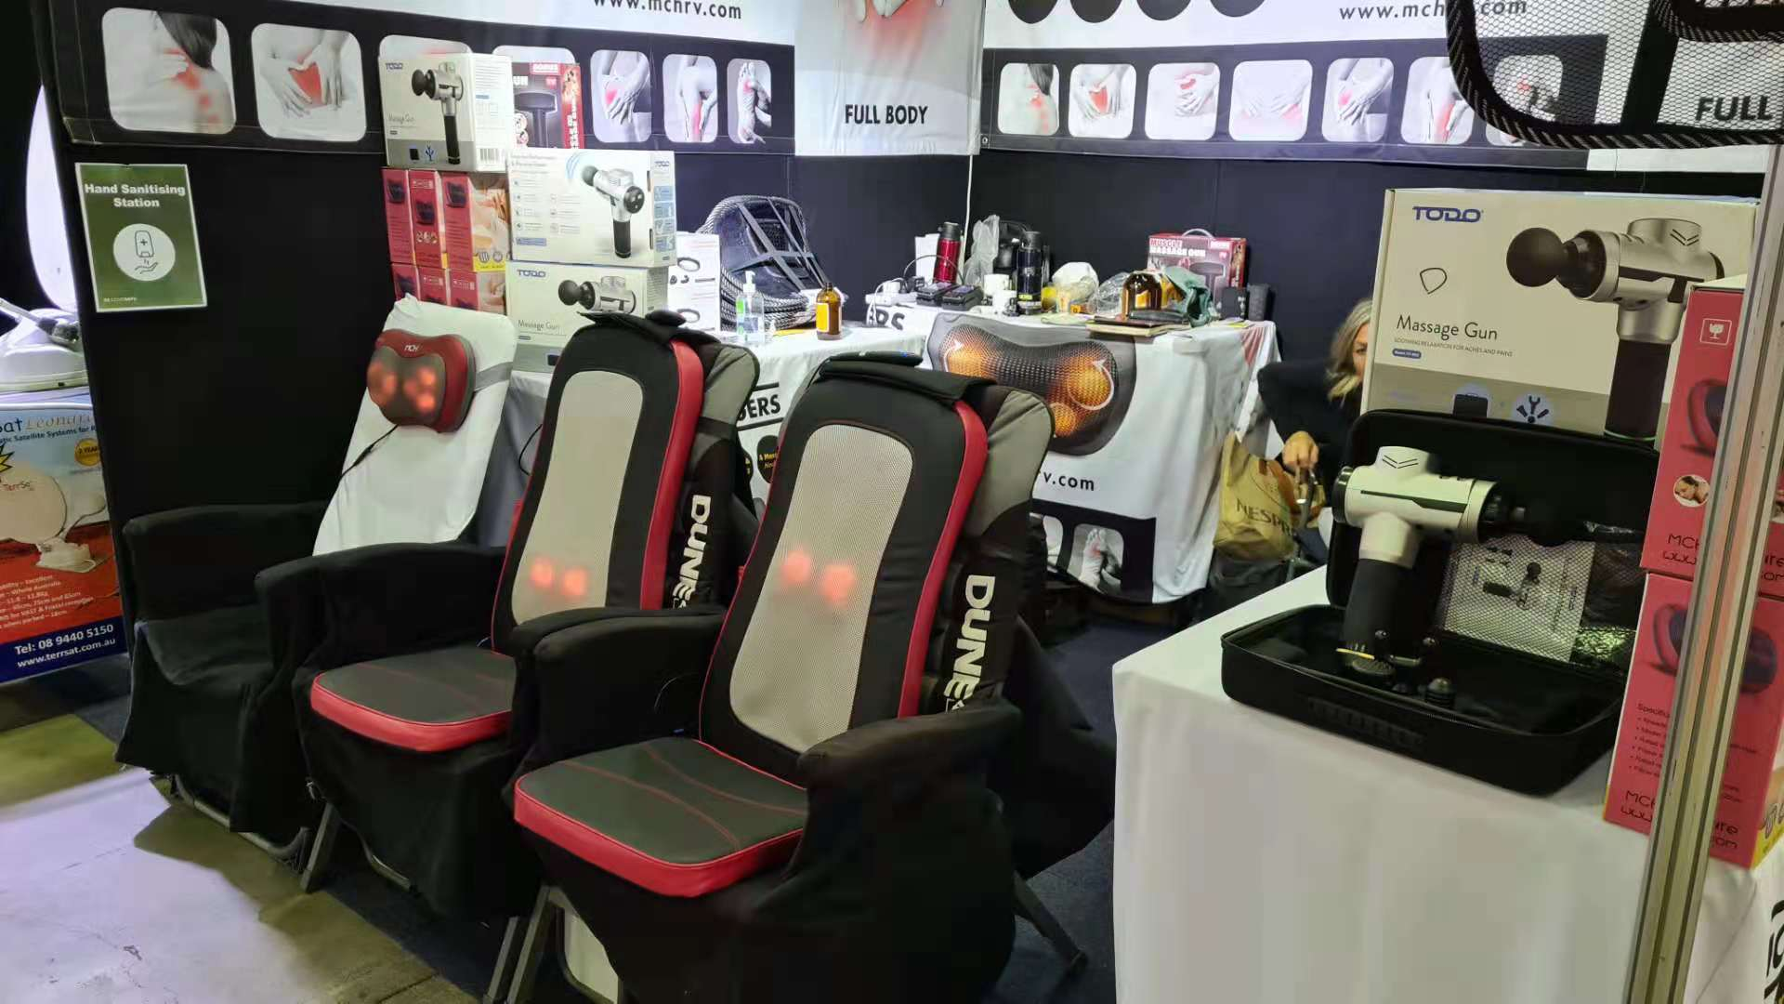
Fair show
展会
Massagers show
Picture from one of our Europe customers
Notes:
更多模板下载地址：http://www.pptvzaixian.com/shop/view28111.html（复制链接到浏览器打开）

Slide 14

Thanks
Reported by Jally Wang
E-mail:jally@lezhimei.cn; Tel/ wechat/ whatsapp:0086 18359748870
Notes:
更多模板下载地址：http://www.pptvzaixian.com/shop/view28111.html（复制链接到浏览器打开）

